Slide 1
Chapter 2
Instructions:
Language of the Computer
Chapter 2_5 ppt

Slide 2
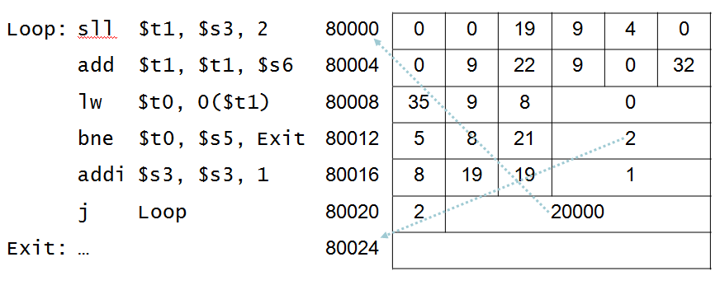
Target Addressing example
Should be 2

Slide 3
Branching Far Away
If branch target is too far to encode with 16-bit offset, assembler rewrites the code
Example
  beq $s0,$s1, L1
  ↓
  bne $s0,$s1, L2
  j L1
  L2: …

Slide 4
RISC Vs. CISC
Complex instruction set makes implementation difficult
  Hardware translates instructions to simpler microoperations
    Simple instructions: 1–1
    Complex instructions: 1–many
  Microengine similar to RISC
  Market share makes this economically viable
Comparable performance to RISC
  Compilers avoid complex instructions

Slide 5
Fallacies
Powerful instruction ⇒ higher performance
  Fewer instructions required
  But complex instructions are hard to implement
    May slow down all instructions, including simple ones
  Compilers are good at making fast code from simple instructions
Use assembly code for high performance
  But modern compilers are better at dealing with modern processors
  More lines of code ⇒ more errors and less productivity

Slide 6
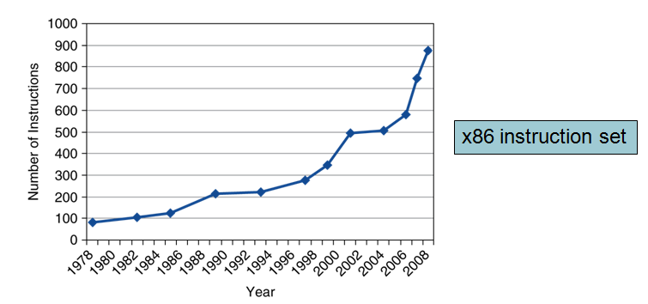
Fallacies

Slide 7
Remarks
Design principles
  1. Simplicity favors regularity
  2. Smaller is faster
  3. Make the common case fast
  4. Good design demands good compromises
Layers of software/hardware
  Compiler, assembler, hardware

